Slide 1
Lecture 8 - Recommender Systems
Yanwen Wang
Sauder School of Business
University of British Columbia
March 2018

Slide 2
Recommender Systems
It’s all about similarity.
Similarity of customers to one another.
Similarity of items to one another.
There are many ways to measure similarity, each with pros and cons.
Similarity is also central to many other problems in analytics, data mining and machine learning.
E.g. Clustering, classification, learning

Slide 3


Methods – Collaborative Filtering
User-based filtering

Slide 4
Common Similarity Measures
Minkowski Distance
Manhattan (“city block”) Distance
Euclidean Distance
Cosine Similarity
Correlation

Slide 5
Manhattan and euclidean Distance measure

Slide 6
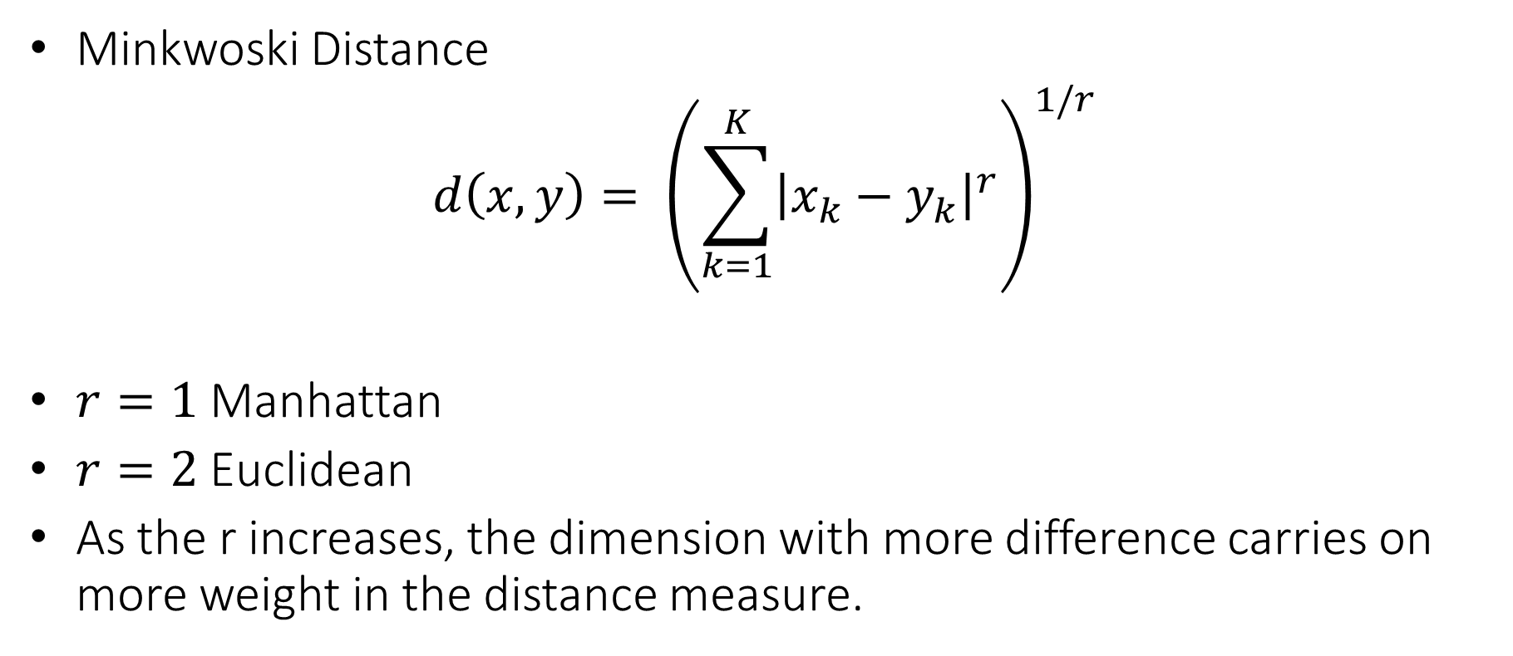
Minkowski Distance Measure
Minkwoski Distance
$$d\left(x,y\right)= {\left(\sum_{k=1}^{K}{{\left|x_{k}−y_{k}\right|}^{r}}\right)}^{1/r}$$
$r=1$ Manhattan
$r=2$ Euclidean
As the r increases, the dimension with more difference carries on more weight in the distance measure.

Slide 7
Manhattan Distance
 | Movie 1 | Movie 2
Alice | 1 | 2
Bernard | 5 | 3
+4
0 1 2 3 4 5 6 7
Movie 2
+1
0 1 2 3 4 5 6 7
Movie 1

Slide 8
Euclidean Distance
 | Movie 1 | Movie 2
Alice | 1 | 2
Bernard | 5 | 3
0 1 2 3 4 5 6 7
Movie 2
0 1 2 3 4 5 6 7
Movie 1

Slide 9
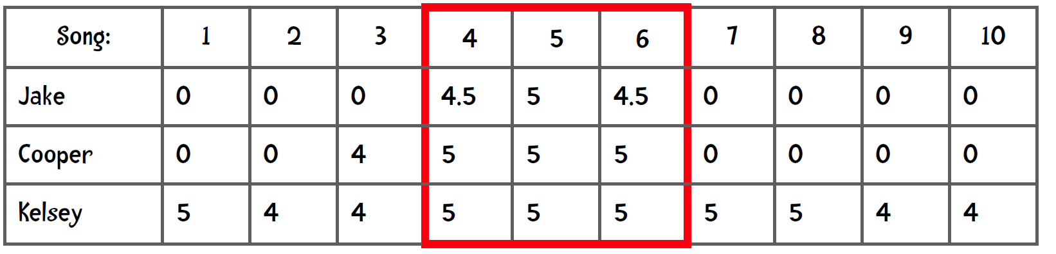
Euclidean and Manhattan Distance with NA values? Replace by Zero?

Slide 10
Euclidean and Manhattan Distance with NA values
What is the Manhattan distance?
Impute estimated values for missing dimension using average distance in observed dimensions.
An ‘average’ distance where one computes the distance by using items they rated in common divided by the number of items in common
 | Movie 1 | Movie 2 | Movie 3 | Movie 4 | Movie 5
Alice | NA | NA | 4 | 4 | 5
Bernard | 1 | 2 | 2 | 2 | 3

Slide 11
Cosine Distance measure

Slide 12
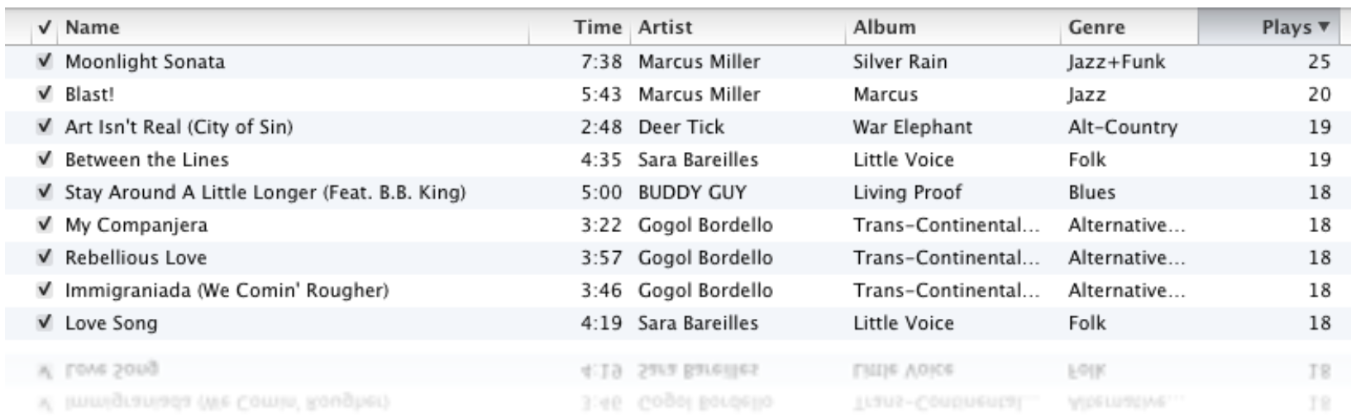
What If I Have Very Sparse Data? Lots of Songs that I Have Never Listened to?

Slide 13
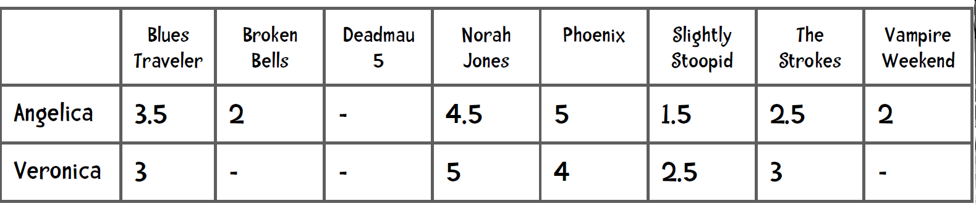

Cosine Similarity Measure
$\cos\left(x,y\right)=\frac{x∙y}{\left\|x\right\|\left\|y\right\|}$ where $∙$ indicates the dot product and indicates the length of the vector $\sqrt{\sum_{i=1}^{n}{x_{i}^{2}}}$
It varies from -1 (180 degrees complete opposite) to (90 degrees orthogonal) to 1 (0 degrees complete the same)

Slide 14
Cosine Similarity – Sensitive to Measure Scales (in case of survey response scaled up by 2?)
Movie 2
Movie 2
0 1 2 3 4 5 6 7
0 1 2 3 4 5 6 7
0 1 2 3 4 5 6 7
0 1 2 3 4 5 6 7
Movie 1
Movie 1

Slide 15
Pearson Correlation Distance measure

Slide 16
Correlation-Based Distance
Who is more similar, Alice-Bernard or Bernard-Cindy?
 | Movie 1 | Movie 2 | Movie 3 | Movie 4 | Movie 5
Alice | 2 | 2 | 4 | 4 | 5
Bernard | 1 | 2 | 2 | 2 | 3
Cindy | 6 | 6 | 8 | 8 | 9

Slide 17
Similarity Metrics Summary
Minkowski distance metrics grow with number of dimensions and are unbounded.
Correlation and Cosine are bounded.
Cosine is usually used for sparse data with lots of zeros. The cosine ignores 0-0 matches.
Cosine should only be used when there is a true and meaningful zero due to scale sensitivity.
Correlation is invariant to the absolute distances between sets of data.

Slide 18
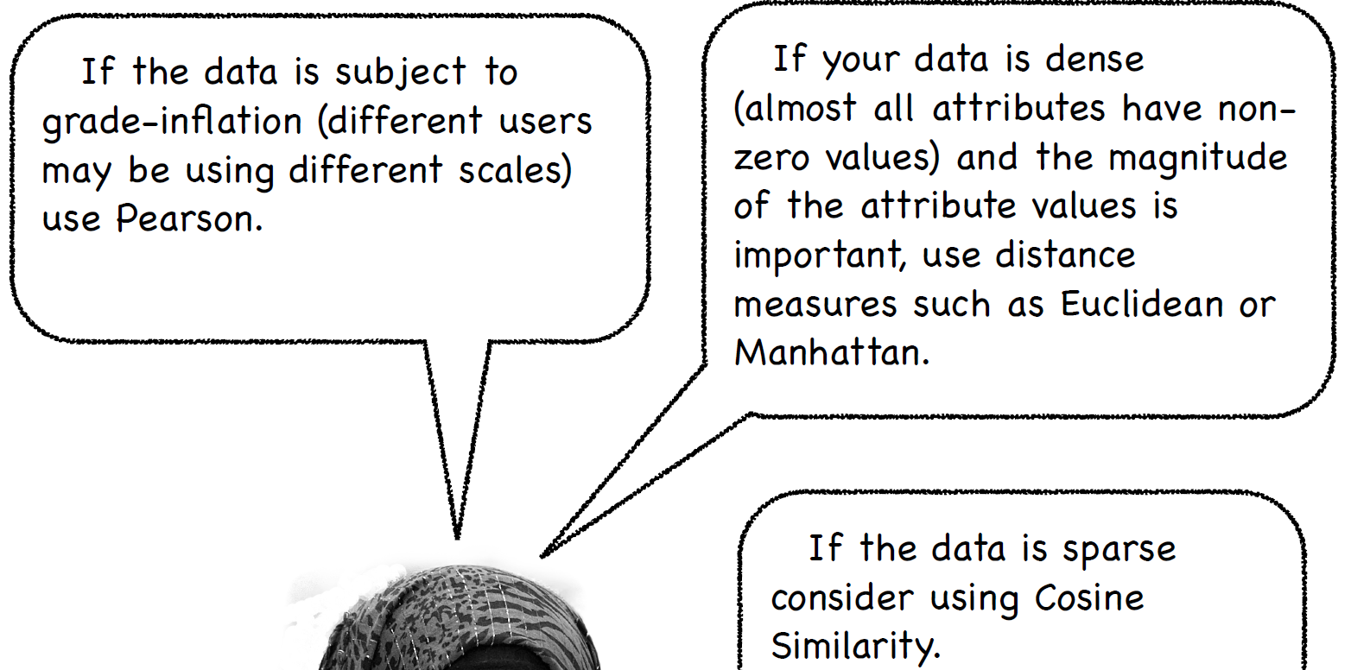
Choice of Distance Measures

Slide 19
User-Based Filtering Algorithm
Calculate similarity of ratings for target customer to all other customers.
Sort customers based on similarity to target customer.
Choose a subset of “k nearest neighbors.”
Calculate predicted ratings using weighted averaging.
Recommend items with high predicted scores that have not been rated/purchased yet.

Slide 20
Drawbacks
Computational demands as user-base grows. Typically the data have more customers than items.
Sparse data. Little overlap between any two customers.

Slide 21
Alternative recommender algorithms
Optional Content (Not Required For the Exam)
Reference Materials (Chapter 3 and 4 on Connect)

Slide 22
Item-Based Filtering (Optional Content)
Create a similarity matrix for all pairwise similarity between items.
Calculate the normalized predicted score for customer X for target unrated item Y as a weighted average of scores for all rated items weighted by similarity to target item.
Repeat for all unrated items.
Convert normalized scores to rating scale.
Recommend an item that has a high predicted score.

Slide 23
Attribute-Based Classification (Optional Content)
Experts paid to evaluate thousands of songs on dozens of attributes, such as genre, tempo, types of instruments, etc.
Similarity matrix computed that captures pairwise similarity between all songs.
Similar songs grouped together in channels or used as recommendations.
The “Song Decoders”; NYTimes, Magazine, October, 2009: http://www.nytimes.com/2009/10/18/magazine/18Pandora-t.html?pagewanted=all&_r=0

